Slide 1
Network Planning and Troubleshooting
Lecture 22
CT4005NI - Computer Hardware and Software
Architectures

Slide 2
21. Introduction
This chapter focuses on advanced networking topics, including network design, network component upgrades.
Objectives
Identify potential safety hazards
Design a network based on the customer's needs.
Determine the components for your customer's network.
Implement the customer's network.
Upgrade the customer's network.
Describe preventive maintenance procedures for networks.
Troubleshoot the network.

Slide 3
21.2 Design a Network Based on the Customer's needs
21.2.1 Determine a Topology
Understand the customer's need and determine the general layout of new network.
Following network decision need to be discussed:
• Cable and wireless types
• Expandability
• Number and location of users
The number of users and the estimated amount of future growth determines the initial physical and logical topology of the network.
An inspection, called a site survey, should be done early in the project

Slide 4
21.2 Design a Network Based on the Customer's needs
You should create a checklist to record the needs of your customer:
The location of users' computers
The position of network equipment such as switches and routers
The position of the server
A floor plan or blueprint is helpful to determine the physical layout of equipment cables.
If not available, you should make a drawing of where the network devices will be located using software like MS Visio.

Slide 5
21.2.2 Determine Protocols and Network Applications
In the design of a network, you must determine the protocols that are going to be used.
Some protocols are proprietary while some are open standard.
Consider the following when selecting protocols:
The TCP/IP suite of protocols is required for every device to connect to the Internet.
This makes it a preferred protocol for networking.
NetBEUI is a small, fast protocol that is useful in low security networks.
It performs well in a small network that is not connected to the Internet.
IPX/SPX is a protocol used with older versions of Novell Netware.
However, newer versions of Novell Netware use TCP/IP instead of IPX/SPX.
Apple Talk: Apple Macintosh networks have abandoned the AppleTalk protocol for the TCP/IP suite of protocols to ensure connectivity with other TCP/IP networks

Slide 6
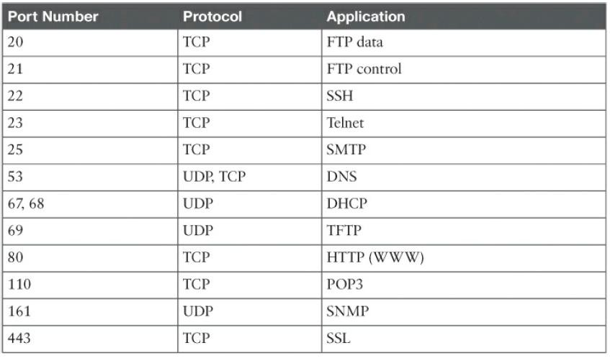
21.2.2 Determine Protocols and Network Applications
Network software applications use these protocols and ports to perform the Internet or over a network.
functions over
Example: Web Page Hosting, sending emails, transferring files.

Slide 7
21.2.2 Determine Protocols and Network Applications
VoIP is a popular example of a network software application.
• It is a method to carry telephone calls over the data networks and Internet.
• It converts the analog signals of our voices into digital information that is transported IP packets.

Slide 8
21.2.2 Determine Protocols and Network Applications
Several ways to use VoIP:
IP phone – A device that connects to an IP network using an RJ-45 Ethernet connector or a wireless connection.
Analog Telephone Adapter (ATA) – A device that connects standard analog devices, such as telephones, FAX machines, to an IP network.
IP phone software – This application connects by using a microphone, speakers, and a
sound card to emulate the IP phone functionality.

Slide 9
21.3 Determine Customer's Network Components
21.3.1 Select Cable Types
Select the cable type that is the most beneficial and cost effective for the users and services.
Cable Types
The size of the network determines the type of network cable that will be used.
Most networks today are wired using one or more types of twisted-pair copper cable:
CAT 5 and CAT 5e
100BASE-TX and 1000BASE-T
CAT 6
10GBASE-T

Slide 10
21.3 Determine Customer's Network Components
Wireless
• A wireless solution may be possible in places where cables cannot be installed.
• Example: an older, historic building.
Cost
• When designing a network, cost is a consideration.
• Installing cable is expensive but is a one-time expense.
Security
• A wired network is usually more secure than a wireless network.
• It is easier to gain unauthorized access to the signals on a wireless network signals on a wired network.
Design for the Future
• Many organizations install the highest grade of cable that is available to ensures that the
networks are prepared for additional bandwidth requirements in the future.

Slide 11
21.3 Determine Customer's Network Components
21.3.2 Select an ISP Connection Type
There are three main considerations for an Internet connection:
Speed
Reliability
Availability

Slide 12
21.3 Determine Customer's Network Components
21.3.3 Select Network Cards
• Before selecting NIC, one should research about Speed, Form Factor, and Capabilities that the card offers.
• Ensure, speed and capabilities of the hub or switch.
• Ethernet NICs may be backward-compatible:
If you have a 10/100 Mbps NIC and a hub that is only 10 Mbps, the NIC will operate at 10 Mbps.
If you have a 10/100/1000 Mbps NIC and a switch that is only operating at 100 Mbps, the
NIC will operate at 100 Mbps.
• If you have gigabit switch, it is recommended to use gigabit NIC to match speed

Slide 13
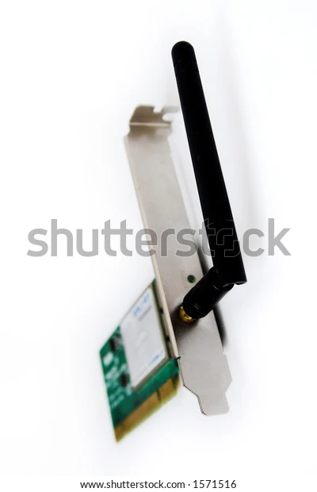
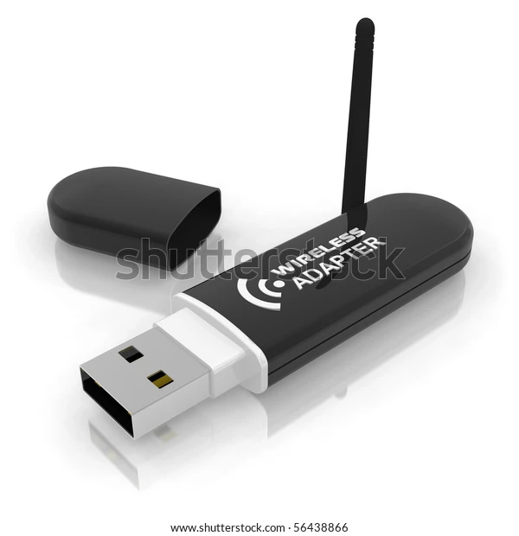
21.3 Determine Customer's Network Components
Wireless NICs
Wireless NICs are available in various formats and capabilities.
802.11b NICs can be used on 802.11g networks.
802.11a can be used only on a network that supports 802.11a.
802.11b, and 802.11g NICs can be used on 802.11n networks.
Notes:
Wireless NIC card:https://image.shutterstock.com/image-photo/wireless-network-pci-card-wlan-600w-1571516.jpg
Usb wifi:https://image.shutterstock.com/image-illustration/usb-wireless-adapter-600w-56438866.jpg

Slide 14
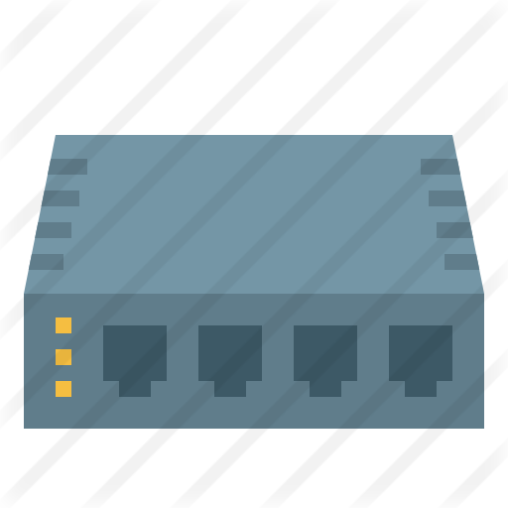
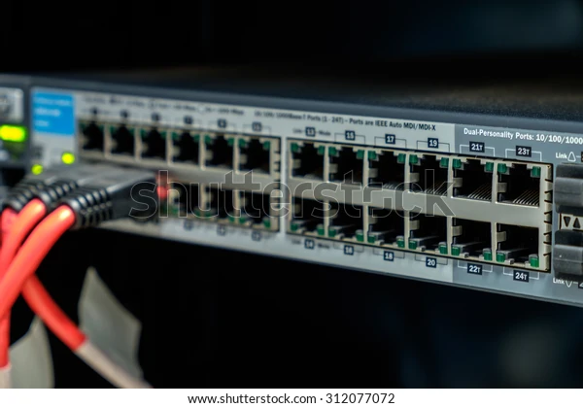
21.3 Determine Customer's Network Components
21.3.4 Selecting Network Device
Hubs
A hub is used to share data between multiple devices on a section of the network.
A hub can extend the reach of a network as it regenerates the data that passes through it.
Hubs do not segment network traffic, so they decrease the amount of available bandwidth to any device.
As it cannot filter data, a lot of unnecessary traffic constantly moves between all the
devices connected to it.
Notes:
Hub:https://www.shutterstock.com/image-photo/network-hub-312077072#
Hub vector icon:https://www.flaticon.com/premium-icon/icons/svg/2729/2729176.svg

Slide 15
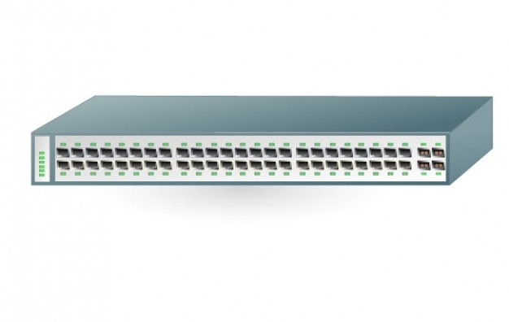
21.3 Determine Customer's Network Components
21.3.4 Selecting Network Device
Switches
Switches have replaced hubs as the central point of connectivity.
Switches filter and segment network traffic by sending data only to the device to which it is sent.
This provides higher dedicated bandwidth to each device on the network.
Switch maintains a Switching Table that contains a list of all MAC addresses on the network.
Notes:
Switch:https://www.freepik.com/free-vector/ethernet-gigabit-switch_397454.htm#page=1&query=network%20switch&position=13

Slide 16
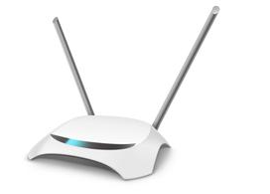
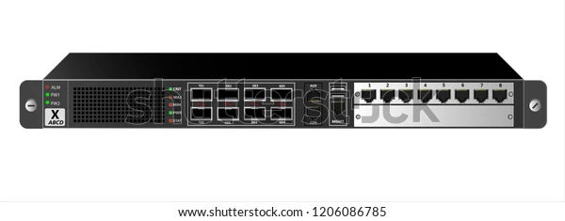
21.3 Determine Customer's Network Components
21.3.4 Selecting Network Device
Routers
• Routers connect networks together.
• On a corporate network, one router ports connects to the WAN connection and the other port connect to the corporate LANs.
• Hence, Router acts as a gateway.
• The wireless router serves as a home gateway, wireless access point, and a switch (Multi function device).
ISP Equipment
• When subscribing to an ISP, you should find out what type of equipment is available so
that you can select the most appropriate device.
• Home users may select to purchase equipment from the ISP.
Notes:
router:https://www.shutterstock.com/image-vector/router-ip-traffic-black-mounting-19-1206086785
Wifi router:https://www.freepik.com/free-vector/wifi-router-wireless-broadband-modem-with-antennas-front-perspective-view_13119648.htm#page=1&query=wifi%20router&position=11

Slide 17
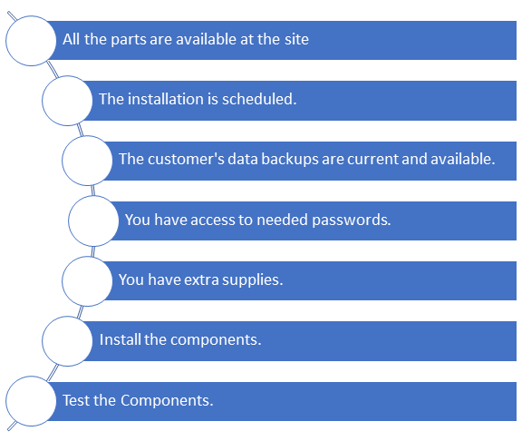
21.4 Implement the Customer's Network
Installation Checklist:

Slide 18
21.4 Implement the Customer's Network
21.4.1 Network Installation Steps
Perform cable pull to install the cable in ceilings and behind walls. Label ends of every cable.
After cable installation, use a cable tester to make sure that there are no shorts or interference.
After installing network interfaces on desktops, laptops, etc. configure the software and IP address information.
Install switches and routers in a secured, centralized location.
Install an Ethernet patch cable from the wall connection to each network device. Also check link lights on devices.
Finally, test the network for connectivity using commands like ipconfig/all and ping (Gateway and other nodes).

Slide 19
21.4 Implement the Customer's Network
21.4.2 Configure Customer's Internet and Network Resources
Default Browser
You can select which browser windows uses by default.
To check, go to "run" and enter a website address.
You can select the particular browser to be default from Settings.
File Sharing
Users can share resources over the network.
You can share a single file, specific folders, or an entire drive.
In Windows 10: Right click folder and select >> Properties >> Sharing >> select Share

Slide 20
21.4 Implement the Customer's Network
21.4.2 Configure Customer's Internet and Network Resources
File permissions:
• Read - to view files and subfolders, data in files, run programs.
• Change - all permissions of Read, along with adding files, changing data and deleting.
• Full Control - all permissions of Read and Change .Also can change permissions on the files and folder.
Printer Sharing
To share printer :
Start >> Control Panel >> Printer and Faxes
Right-click printer icon >> select sharing >> click Share this printer >> ok
To access printer:
Start >> Control Panel >> Printer and Faxes
Click File >> Add Printer >> use Add Printer wizard to find and install

Slide 21
21.5 Upgrade the Customer's Network
21.5.1 Install and Configure a wireless NIC
Remove the Computer case cover.
Install the wireless NIC into an available PCI slot or PCI express slot.
After the wireless NIC is installed, configure the device drivers and enter the IP address information.
Static IP addresses requires to be changed when computer is connected to different network.
Hence, enable DHCP to receive IP address.

Slide 22
21.5 Upgrade the Customer's Network
21.5.2 Install and Configure a Wireless Router
There are several configurations that can help secure and increase the speed of a wireless network.
802.11 protocol selection
If all wireless devices connect with the same 802.11 standard, maximum speeds can be obtained for that standard.
Static IP address configuration
Static IP address assignments give better protection against network attacks than DHCP.
For example, static IP address assignments allow firewalls to be configured to permit specific traffic or connections between specific devices.

Slide 23
21.5 Upgrade the Customer's Network
21.5.2 Install and Configure a Wireless Router
Service Set Identifier (SSID)
The SSID is the name of the wireless network.
The SSID broadcast allows other devices to automatically discover the name of the wireless
network.
It can be disabled for security.
Firmware update
Firmware updates can improve performance, fix bugs, or update security features.
It can be downloaded from the manufacturer ’s website.

Slide 24
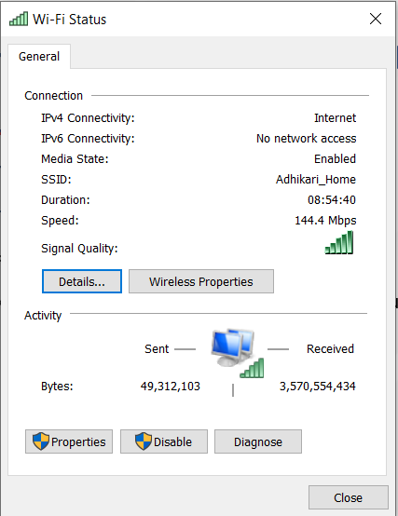
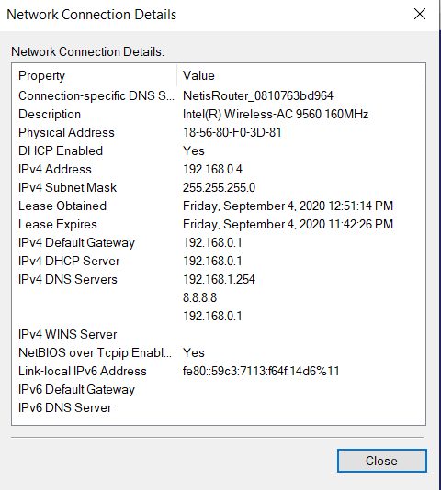
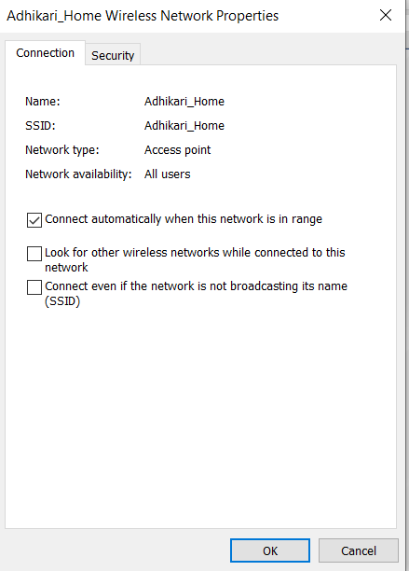
21.5 Upgrade the Customer's Network
21.5.3 Test a Connection
Network Connection
Go to Run >> Type "ncpa.cpl" >> enter
•Double-click Wireless Network Connection to view status.

Slide 25
21.5 Upgrade the Customer's Network
21.5.3 Test a Connection
Ipconfig
It is a CLI tool used to verify that the connection has a valid IP address.
Ping
It is a CLI tool used to test connectivity between devices. You can test your own connection
by pinging your computer.
Tracert: It is a CLI tool used to trace the route that packets take from a source to a destination address.

Slide 26

21.6 Preventive Maintenance for Networks
Preventive maintenance is just as important for the network as it is for the computers on a network.
This will help you to prevent network downtime and equipment failures.
You much check following in a routinely manner:
•condition of cables
•network devices
•servers
•labeling of cables
Notes:
https://www.shutterstock.com/image-photo/network-engineer-working-server-room-194984291

Slide 27
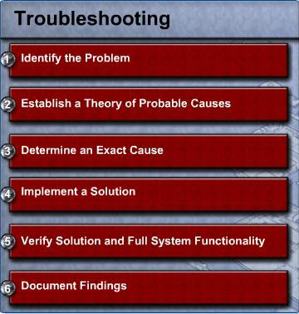
21.7 Troubleshoot the Network

Slide 28
End of Lecture 22

